Slide 1
BuyGadgets.com
Members -
K.A Sai Swagath V. Goutham Reddy Amish Garhwal

Slide 2
Overview
Designed a consumer electronics e-commerce website using MongoDB ,Express , Handlebars and Node.js
Responsive UI design of website using Bootstrap4, HTML5 ,CSS3 and Media Queries
Used passport.js to support authentication using local strategy
Integrated stripe.js for accepting payments from customers
Stored data such as user credentials, product details, order details of user’s using MongoDB
Deployed application to Heroku URL:https://sheltered-castle-69385.herokuapp.com/

Slide 3
Individual Contributions

Slide 4
K.A SAI SWAGATH
Developed login and registration module using passport.js local strategy
Popular products retrieval on home page using product rating property of products
Implemented checkout module by Integrating stripe.js for accepting payments from customers
Appropriate redirection handling for registered and guest users across website
Shopping cart page for users to view the products in their cart and also provided the users an option to edit or remove products from cart
Deployed application to Heroku by hosting mongoDB database on mLab

Slide 5
V . Goutham Reddy
Designed top navigation bar by letting user navigate across website
Developed dynamic category landing page for users to land and view products of their desired category and brand
Implemented dynamic product description page for users to view the full description of products and then add products to cart of their desired quantity
Used express-session for storing anonymous or logged in user activity in session and connect-mongo for storing cart object in mongoDB

Slide 6
Amish Garhwal
Designed static footer navigation pages for providing additional information to the users and the necessary navigation links
Implemented node mailer for delivery of order confirmation email to the users which contains dynamic information based on the order information provided by the user
Integrated Google Maps Api on the contact us page
Enhanced overall look of the application through CSS and Bootstrap

Slide 7
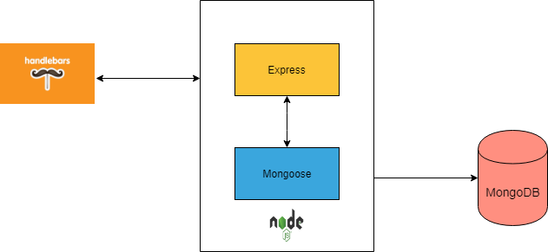
System Architecture

Slide 8
App screenshots

Slide 9
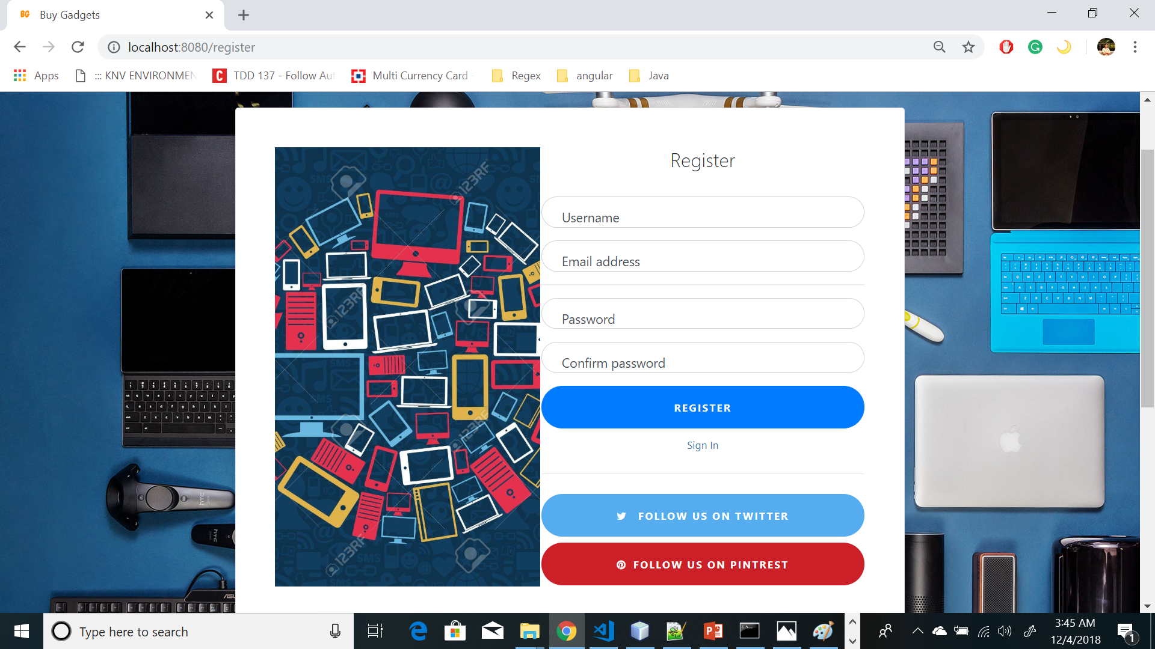
Registration Page

Slide 10
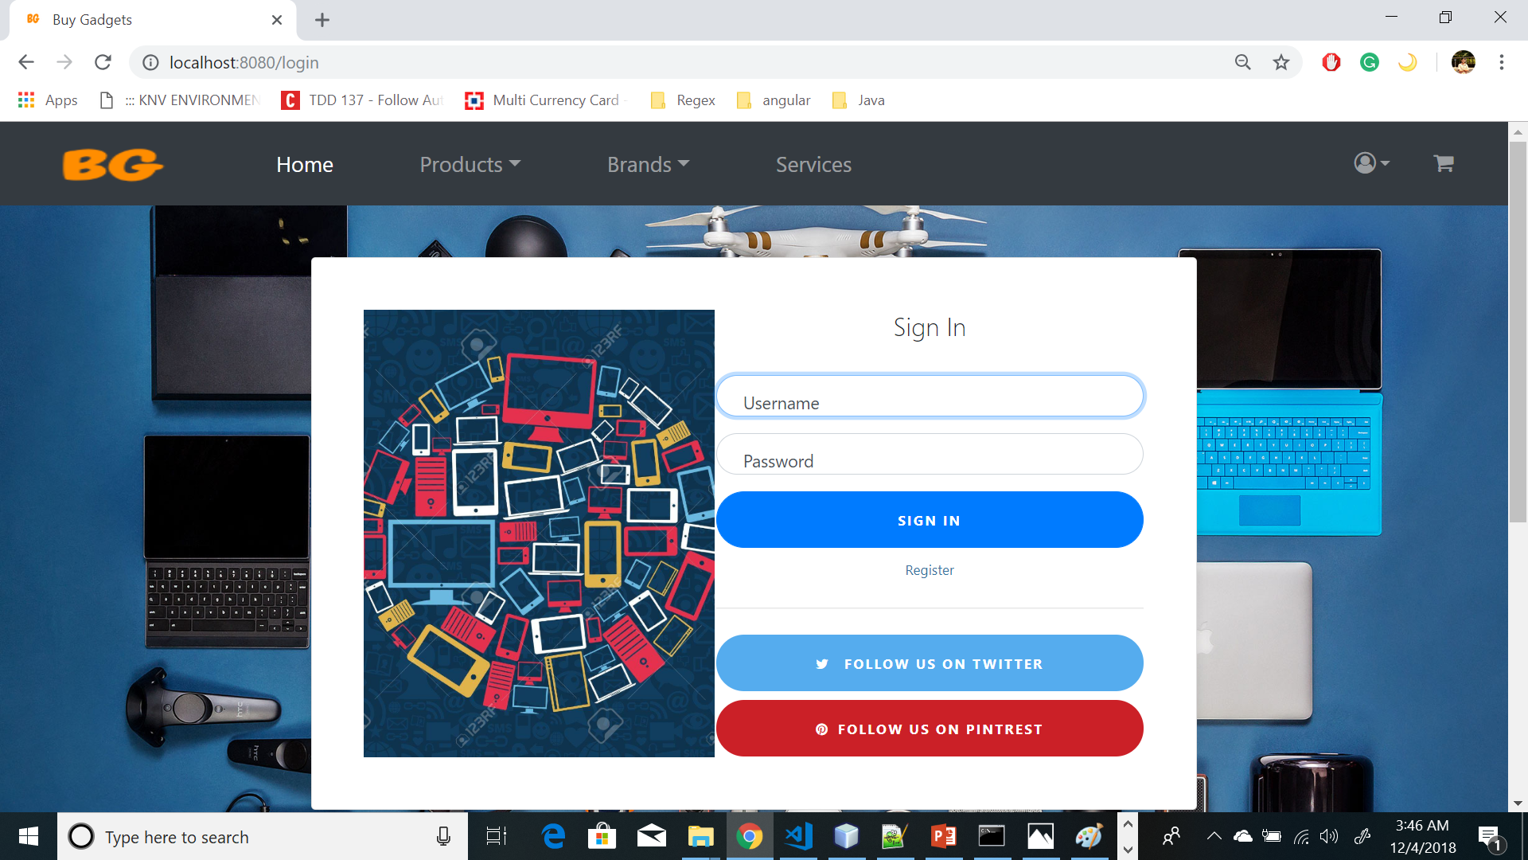
Sign In Page

Slide 11
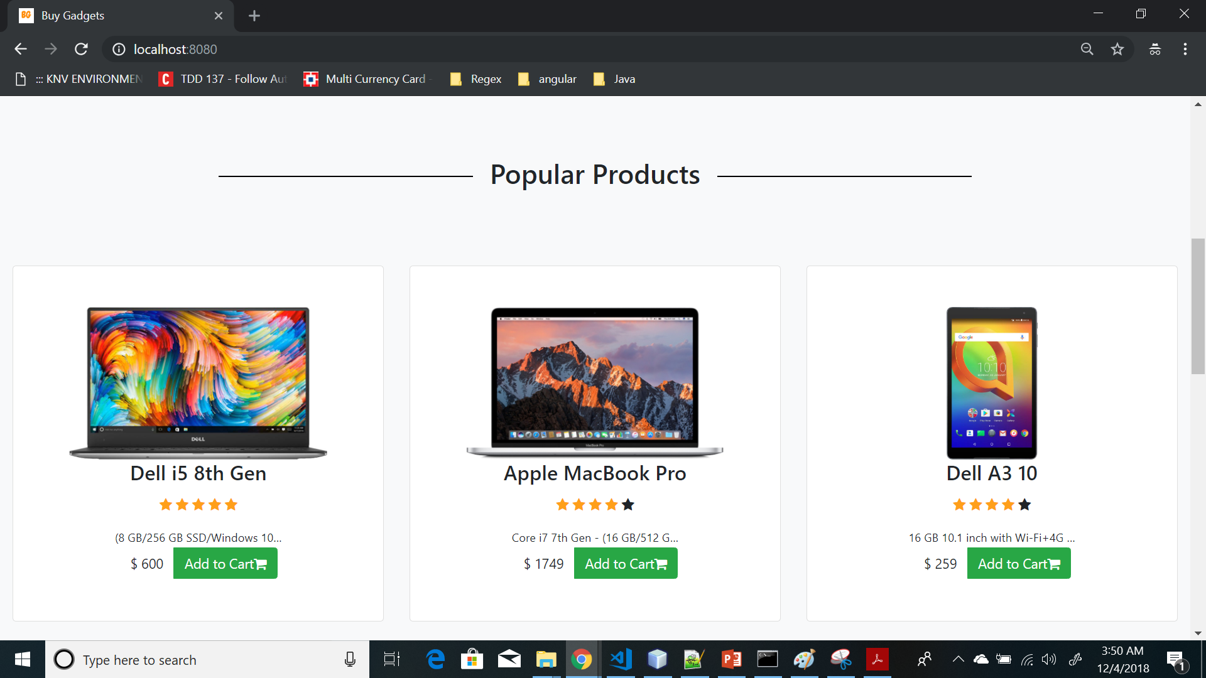
Popular Products

Slide 12
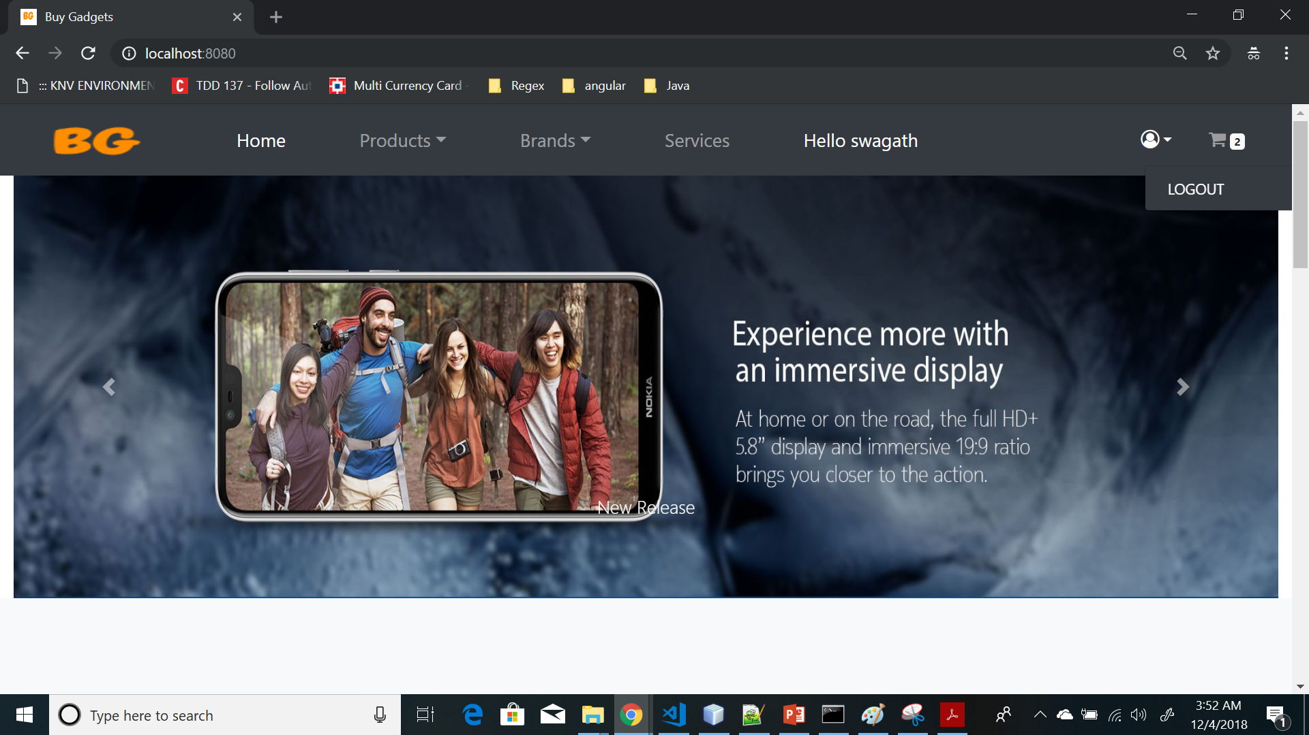
Home Page Carousel

Slide 13
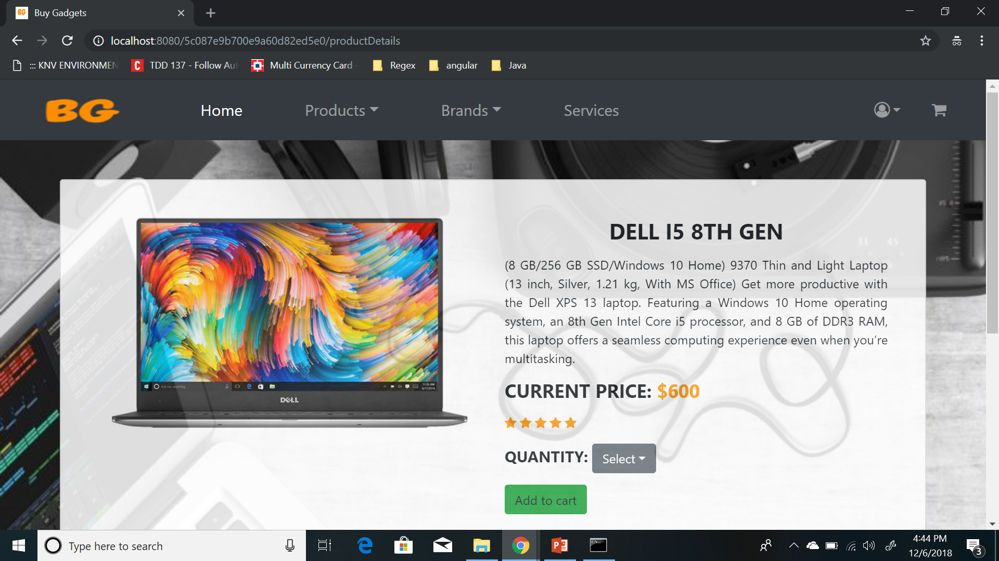
Product Details Page

Slide 14
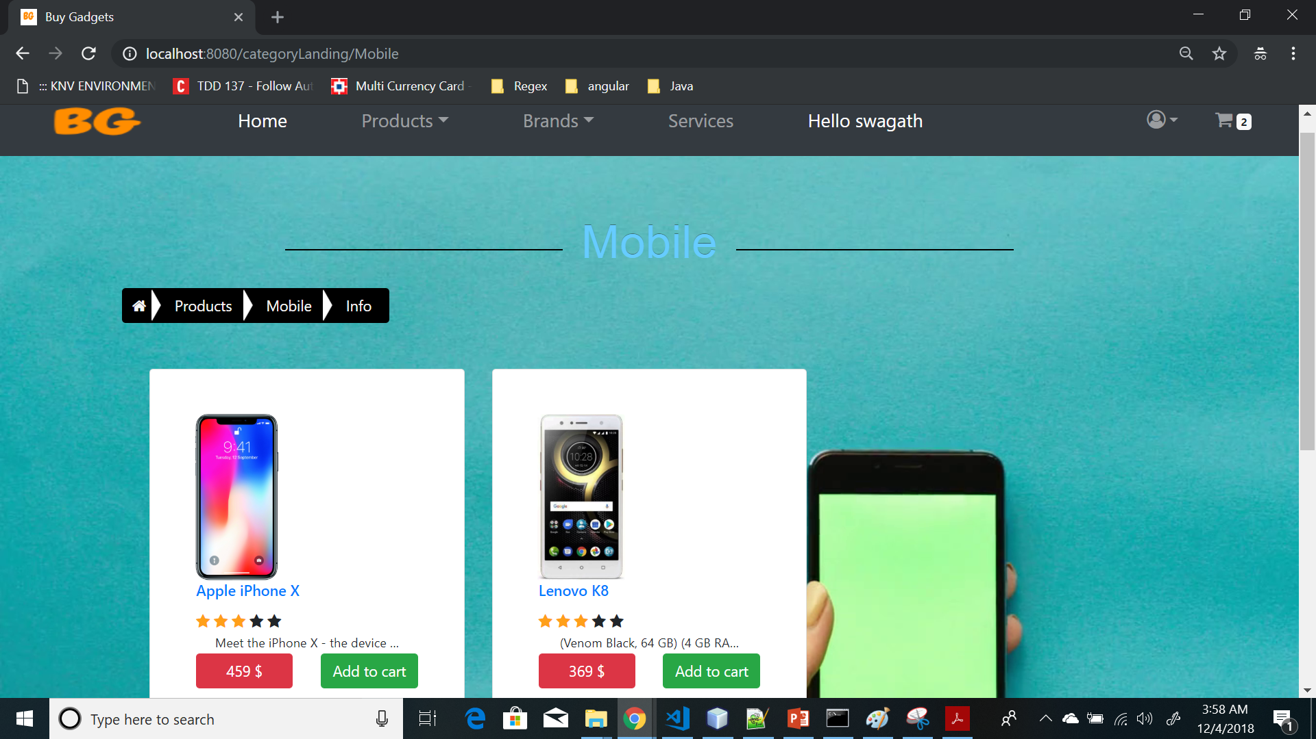
Products By Category

Slide 15
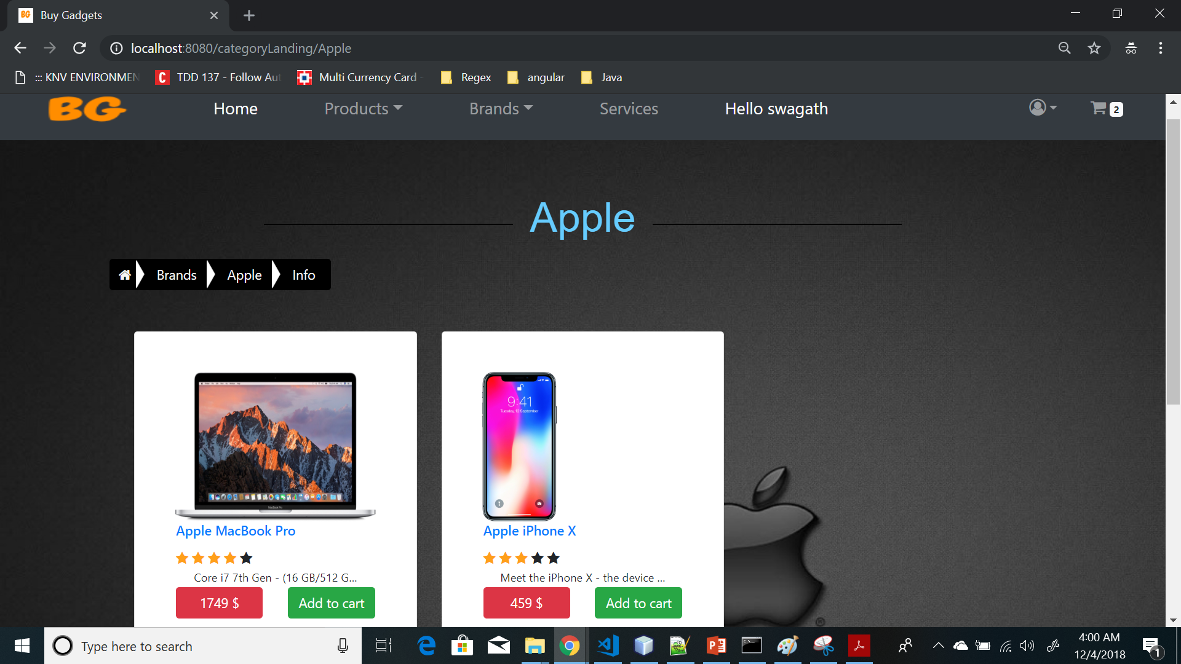
Products By Brand

Slide 16
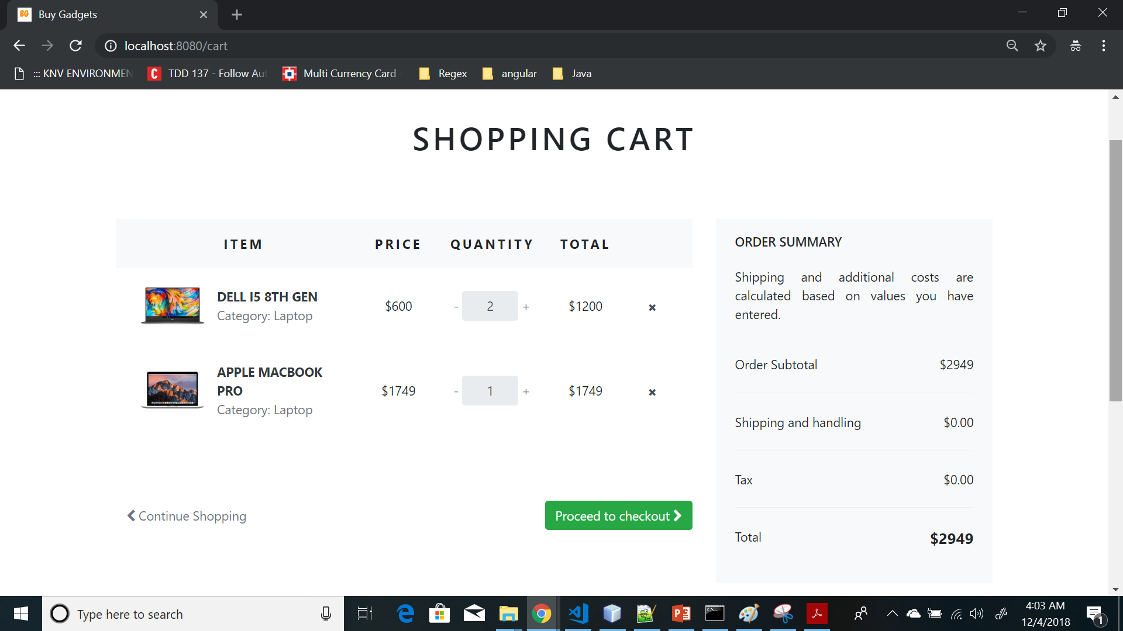
Cart Page

Slide 17
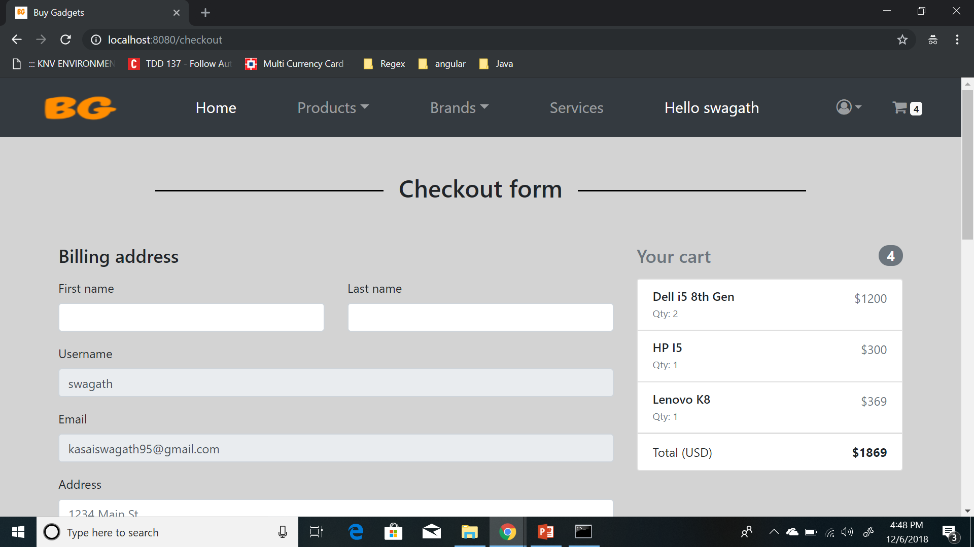
Checkout

Slide 18
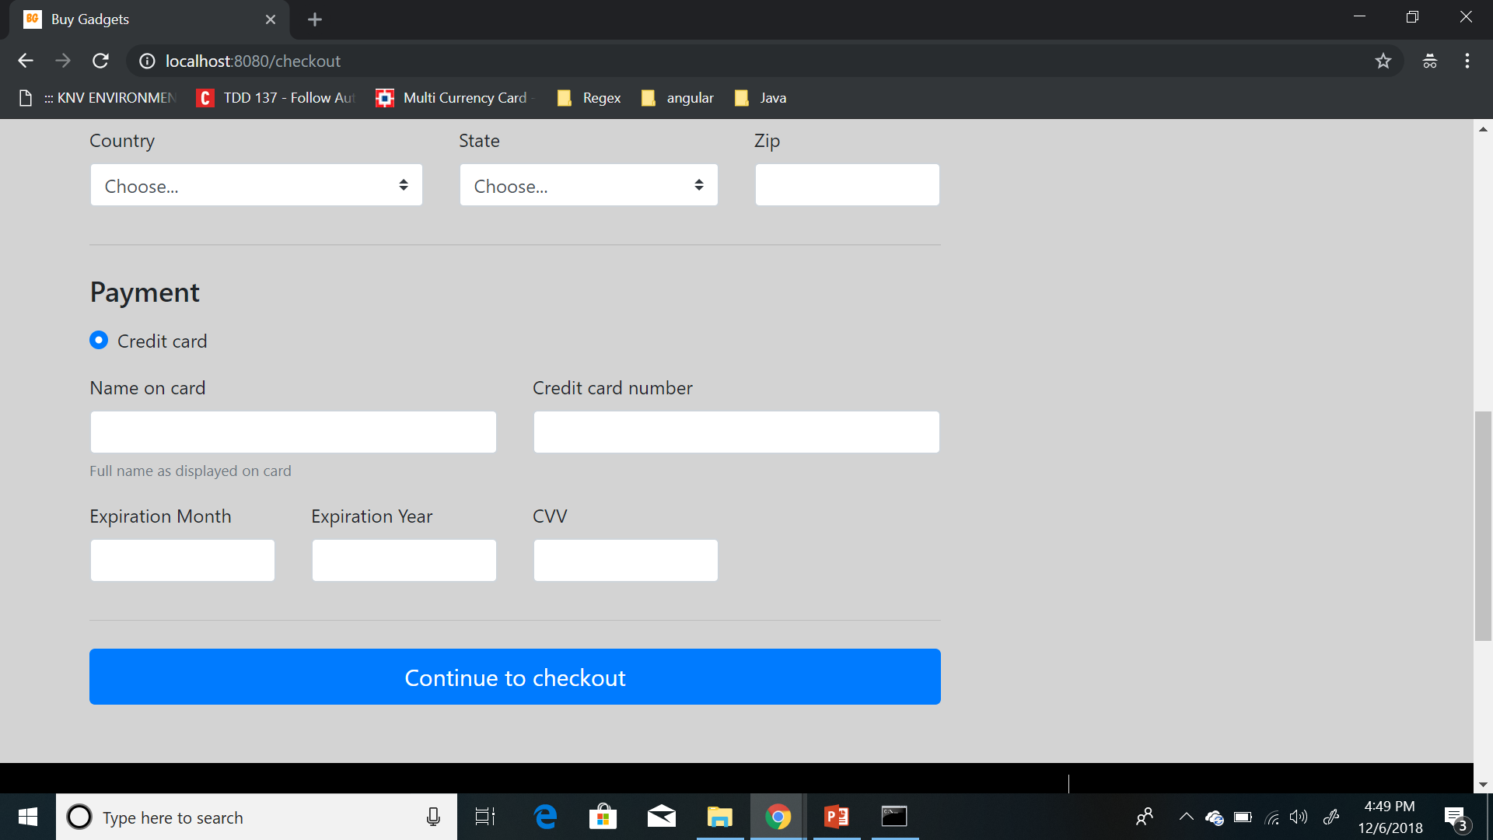
Checkout Cont.…

Slide 19
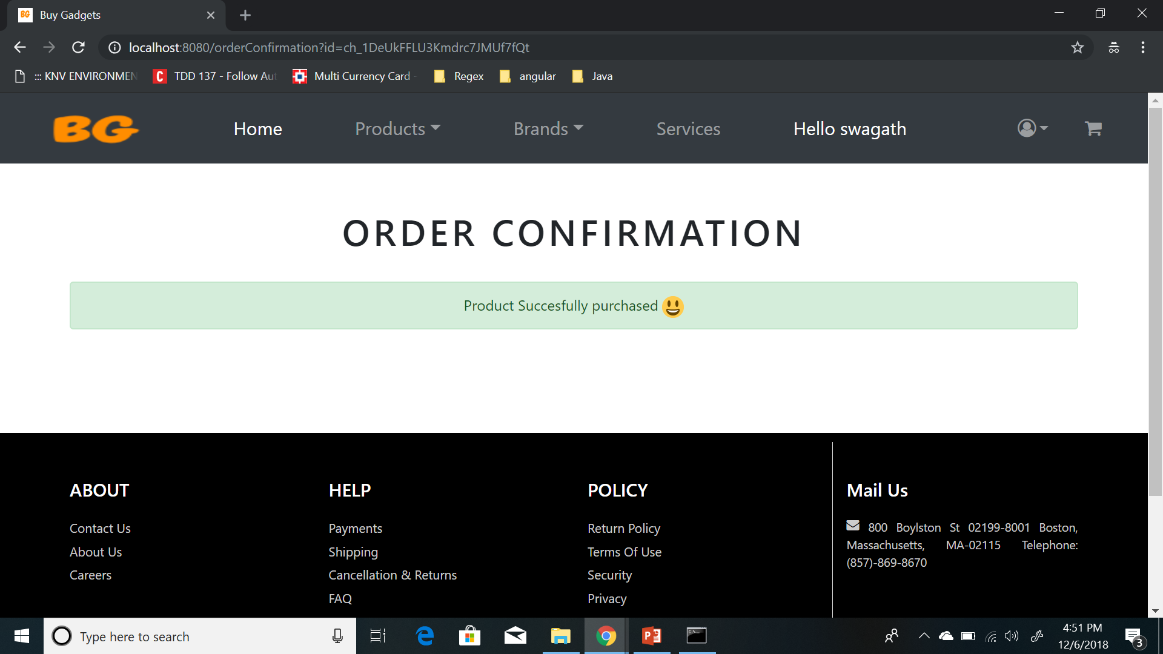
Order Confirmation

Slide 20
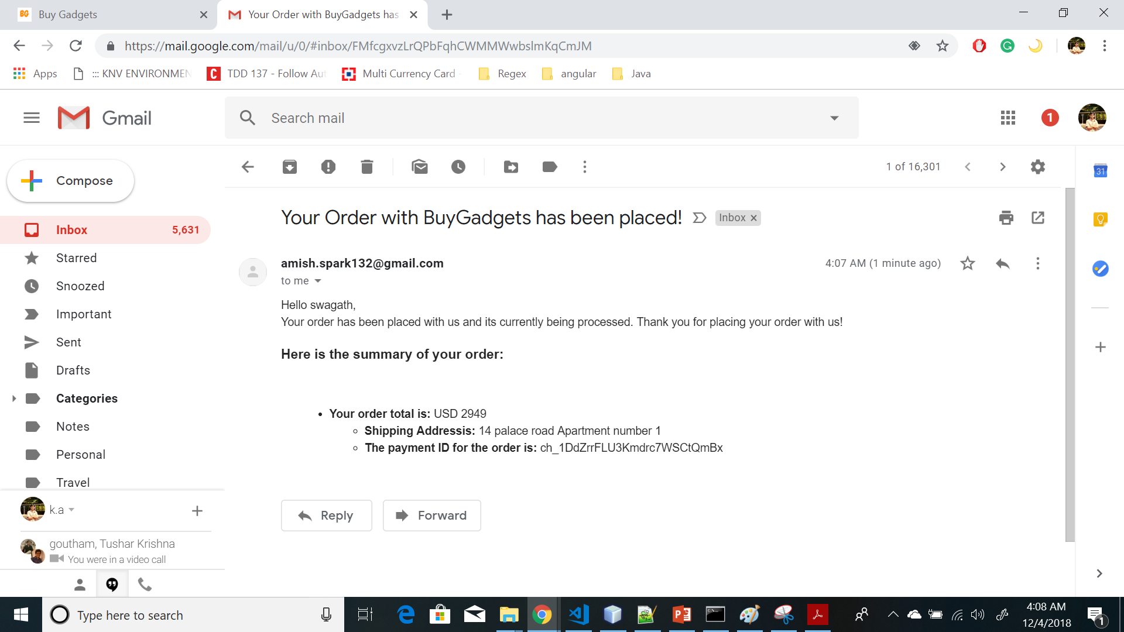
Order Confirmation email

Slide 21
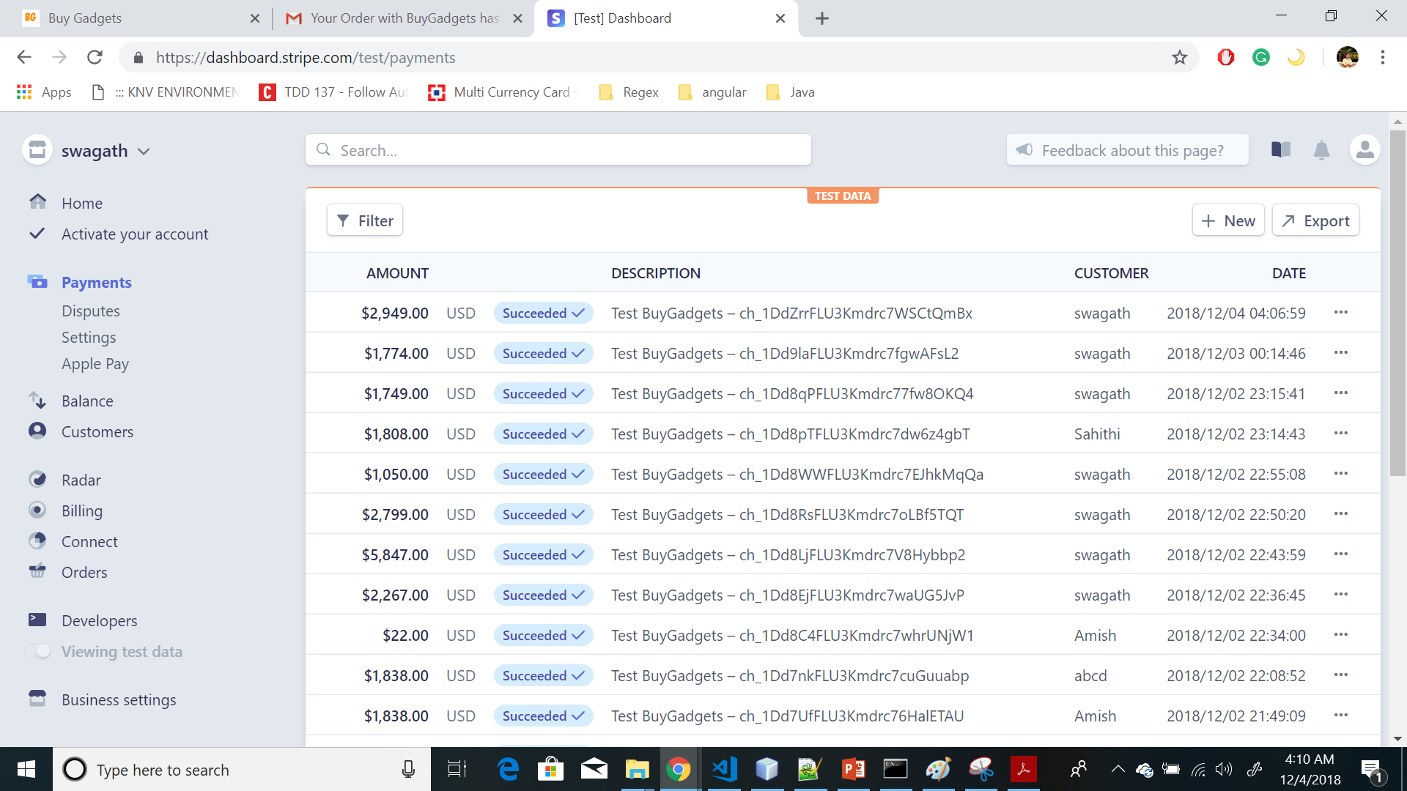
Stripe Payment Records

Slide 22
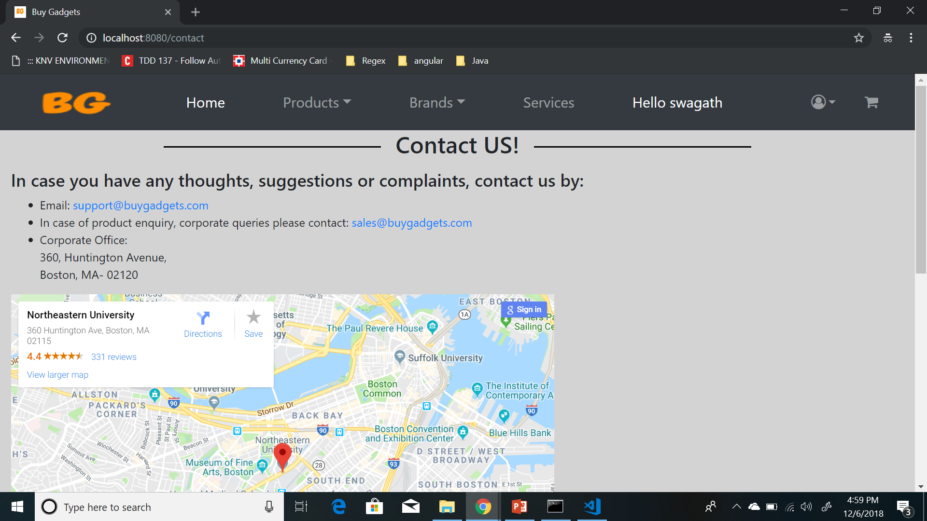
Contact US Page

Slide 23
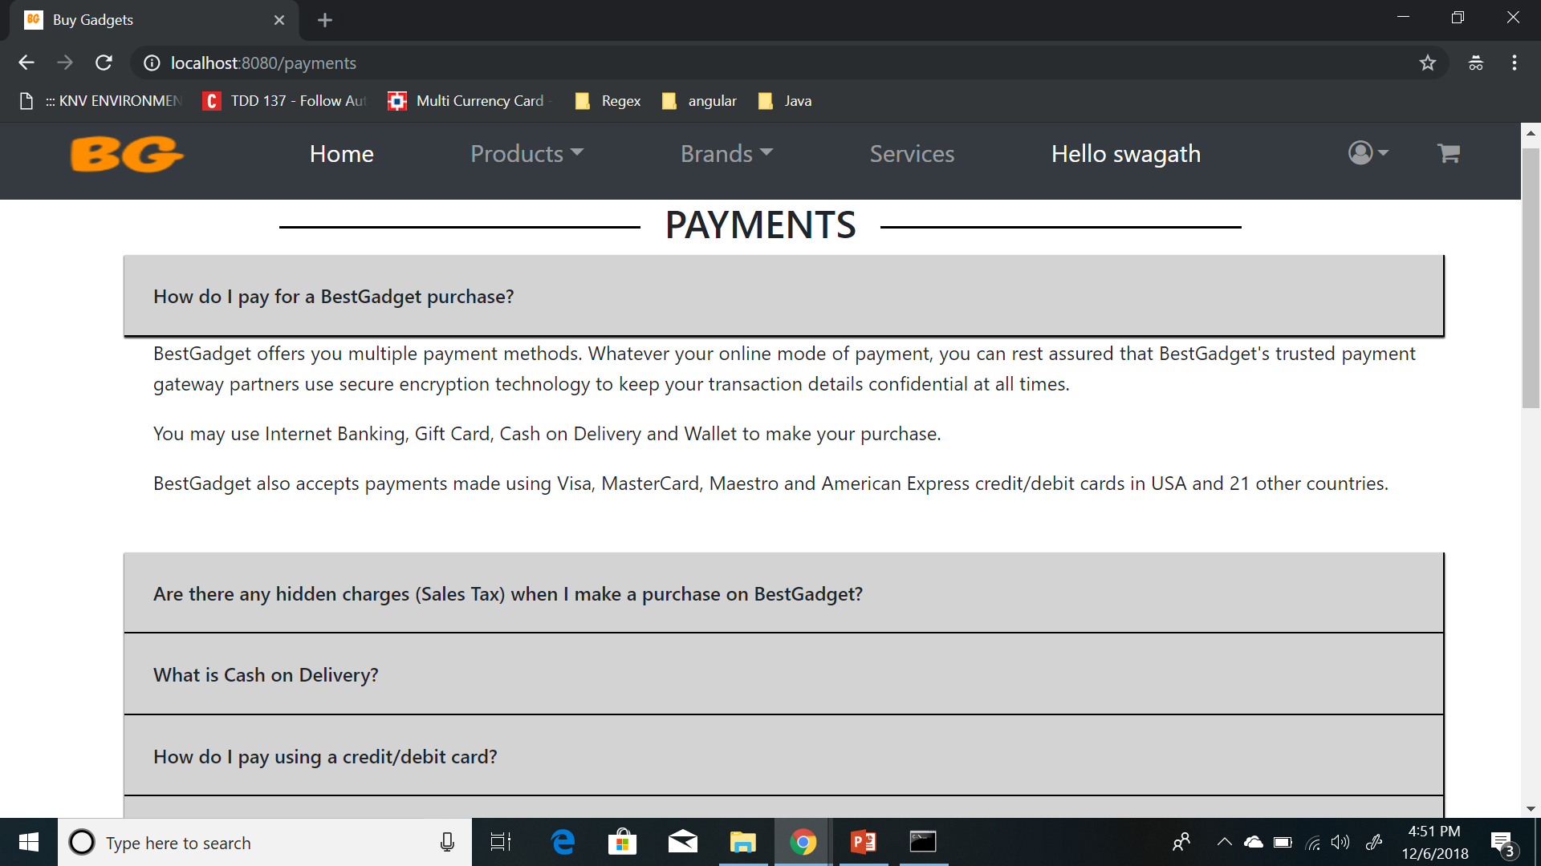
Payments Info(static)

Slide 24
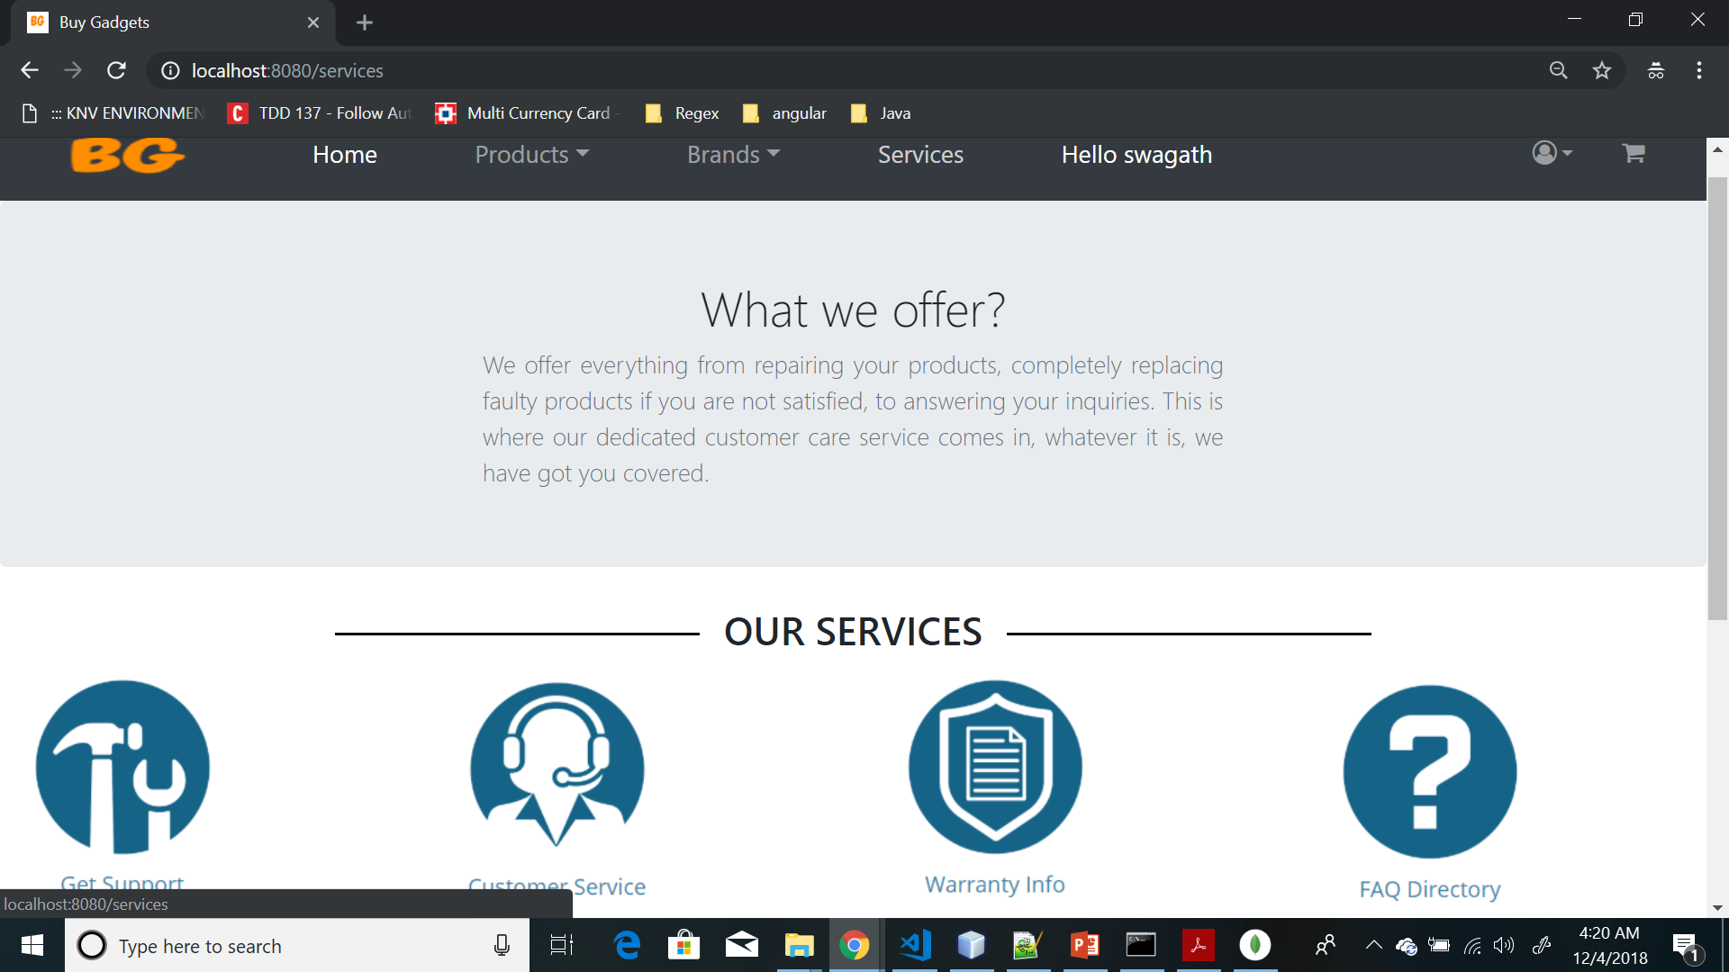
Services Page(Static)

Slide 25
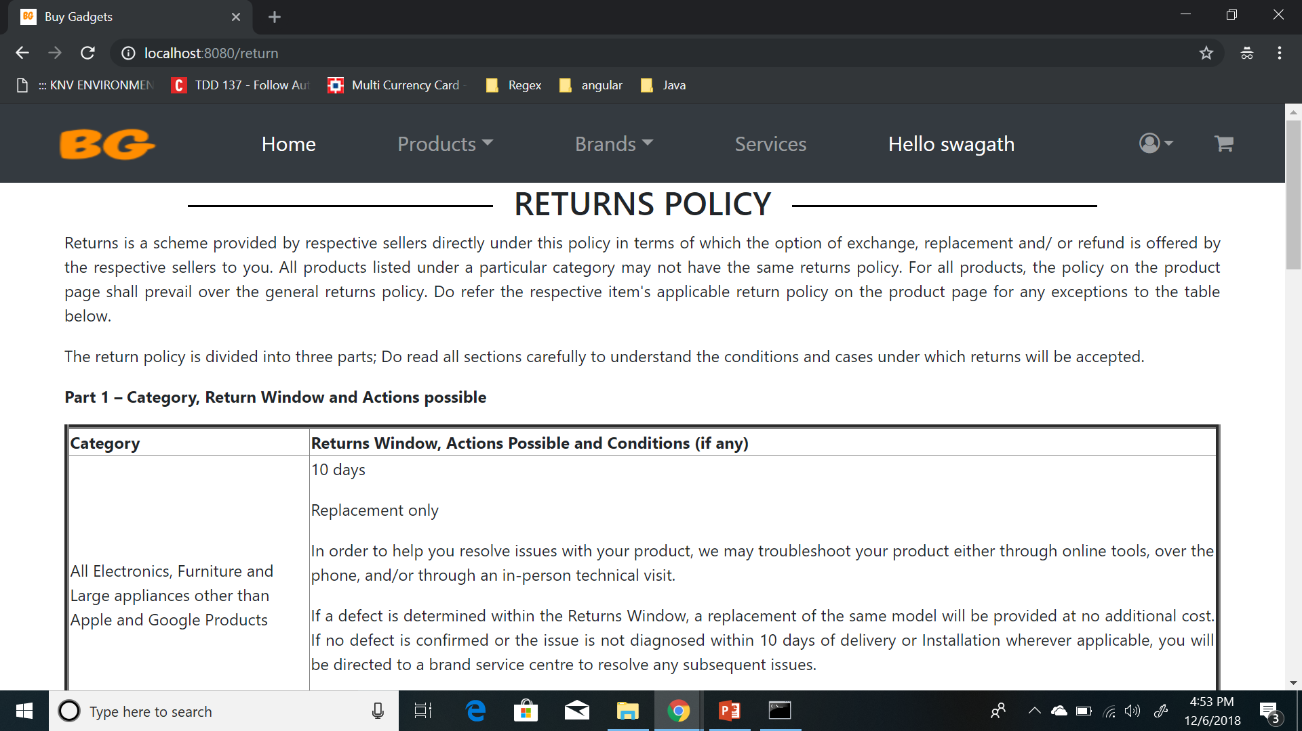
Return Policy Page

Slide 26
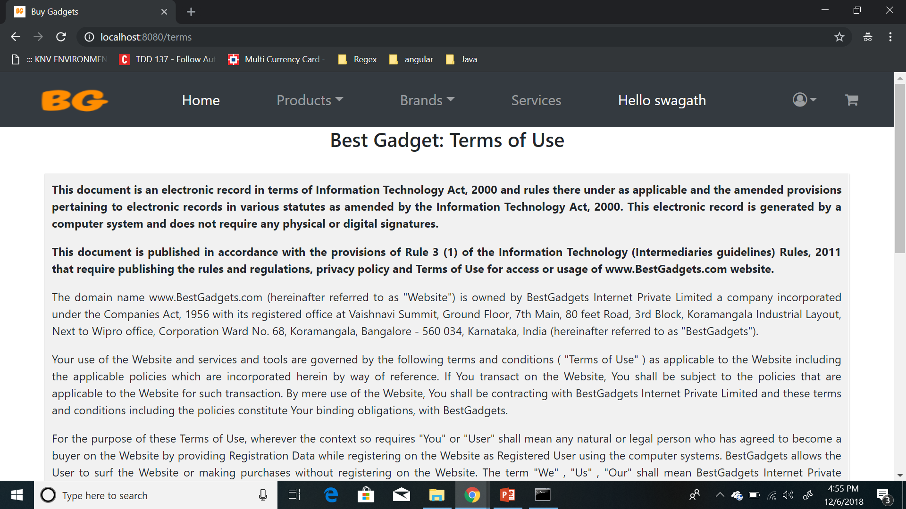
Terms Of Use Page

Slide 27
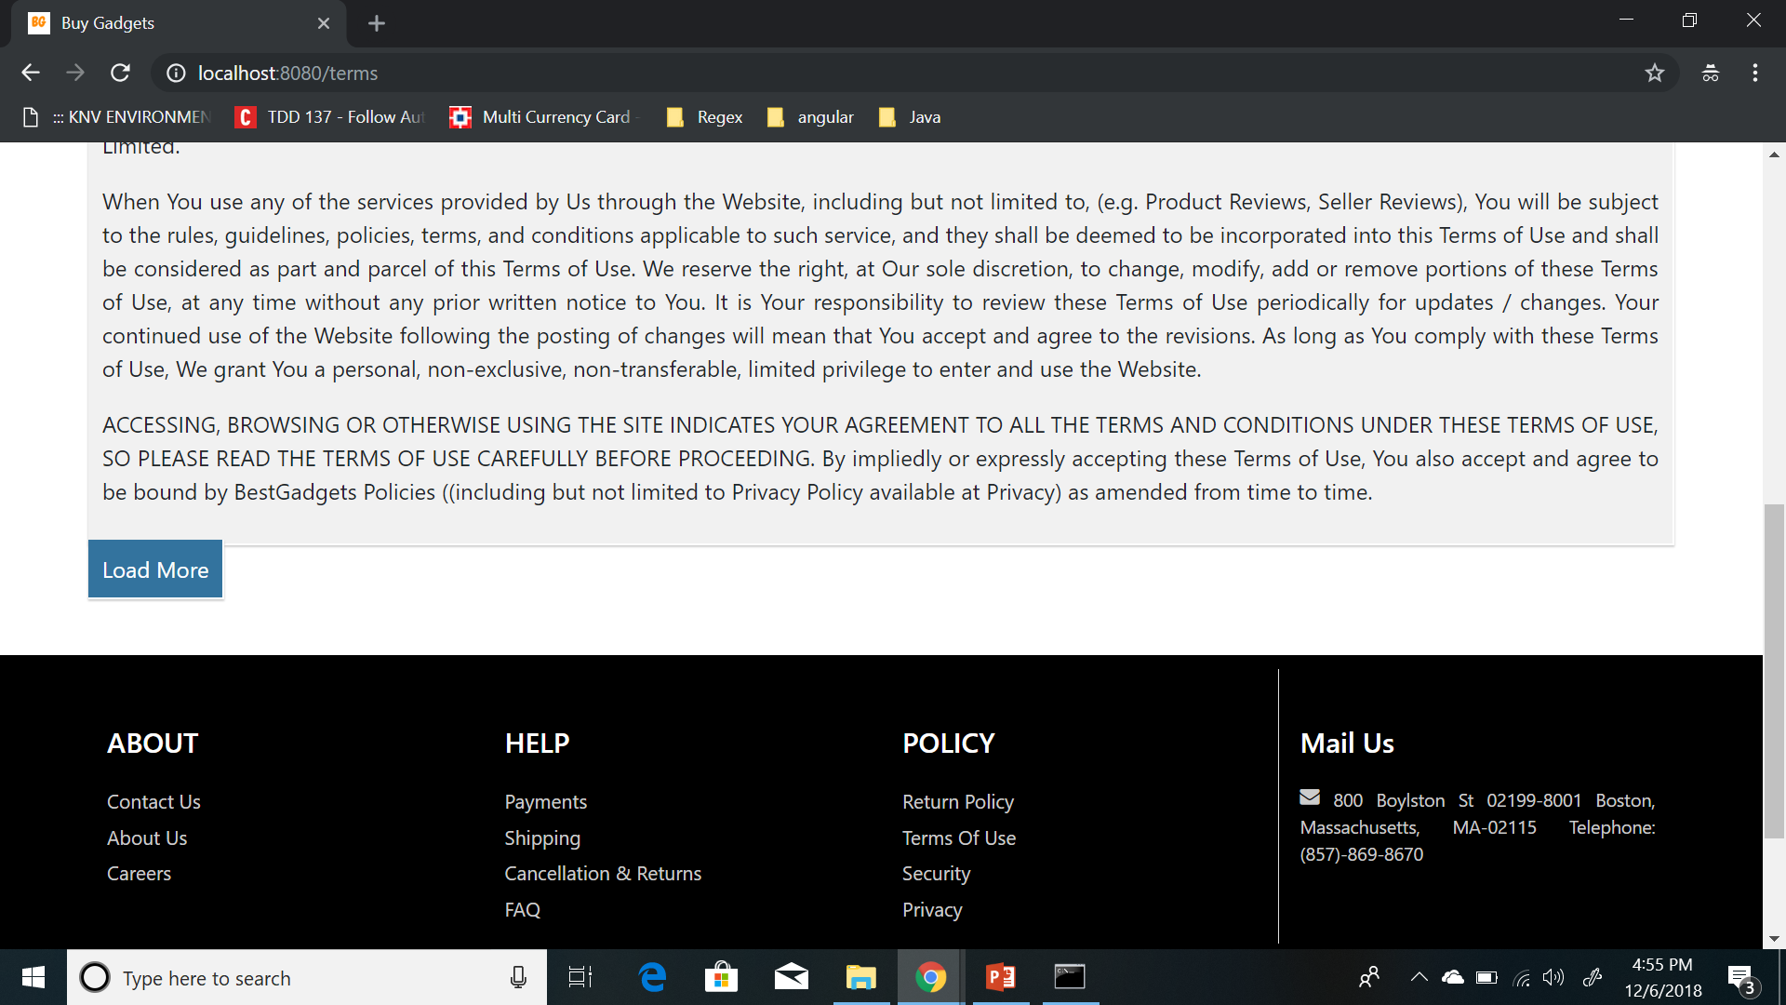
Terms Of Use Page Contd..

Slide 28
Data models
Collections:
users
productbuygadgets
orders

Slide 29
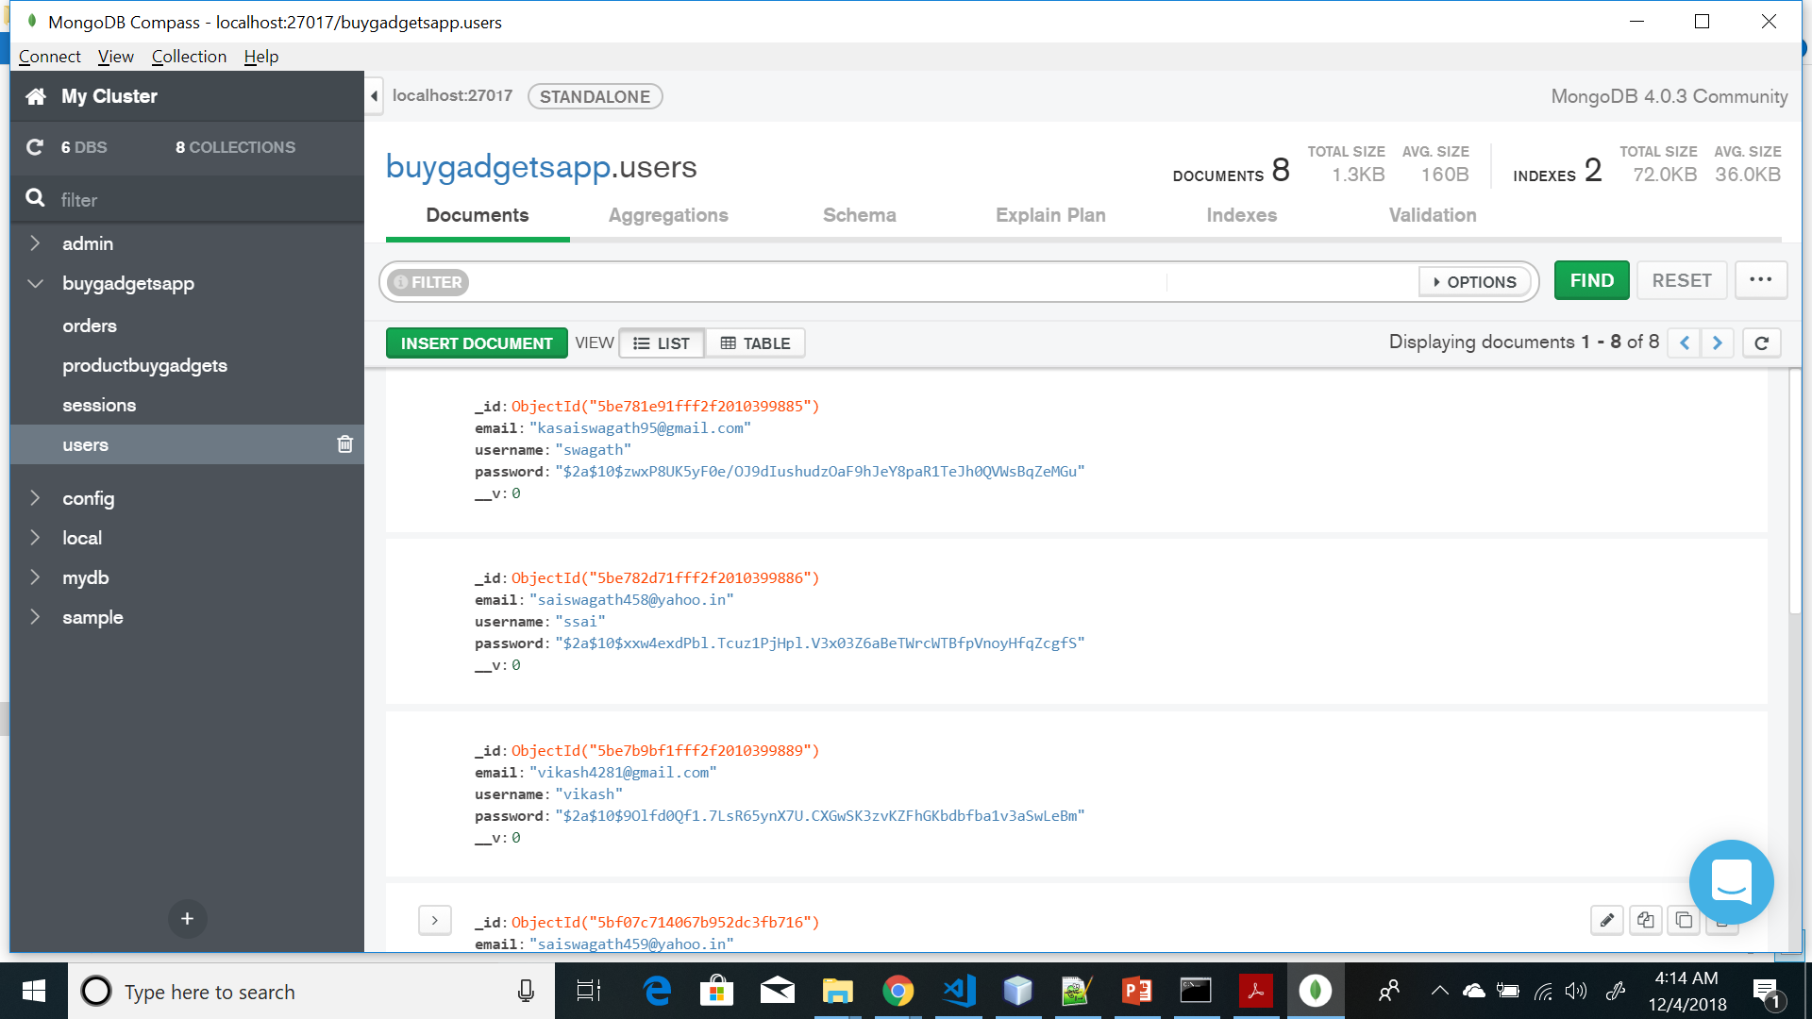
Users Collection

Slide 30
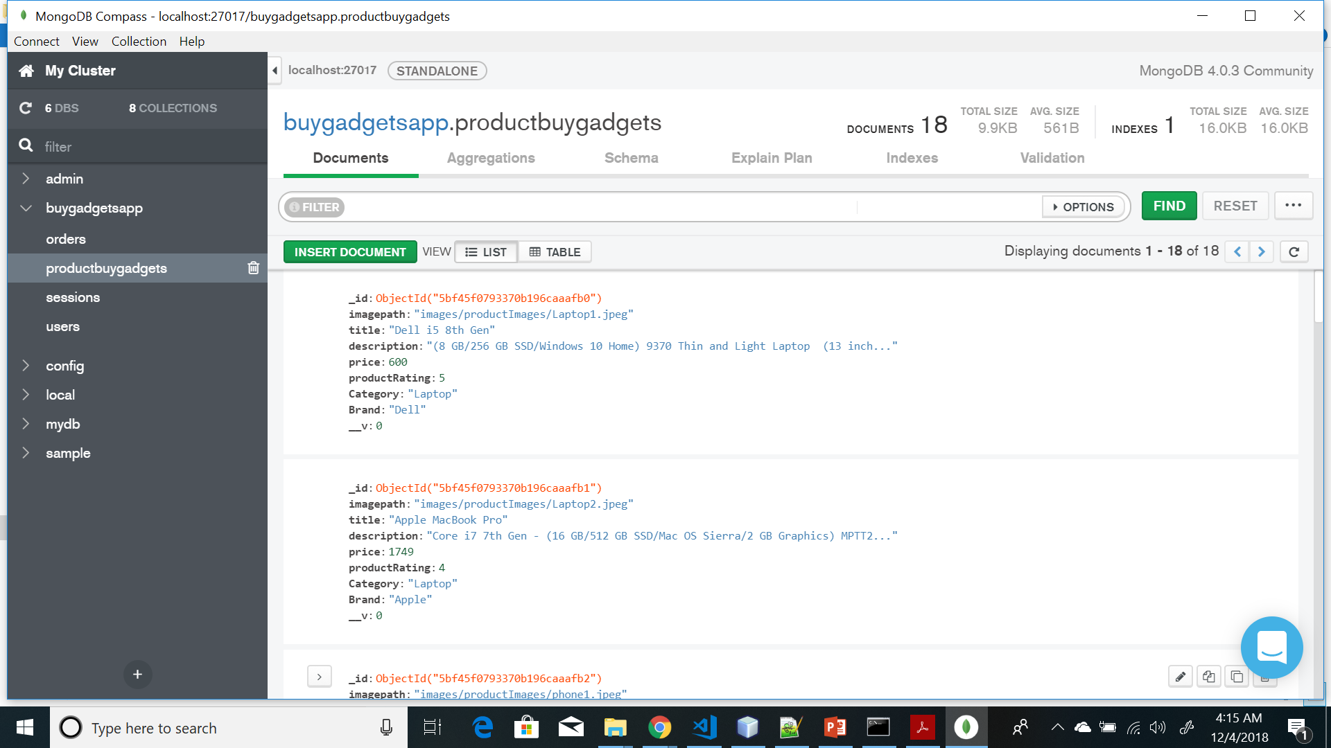
Products Collection

Slide 31
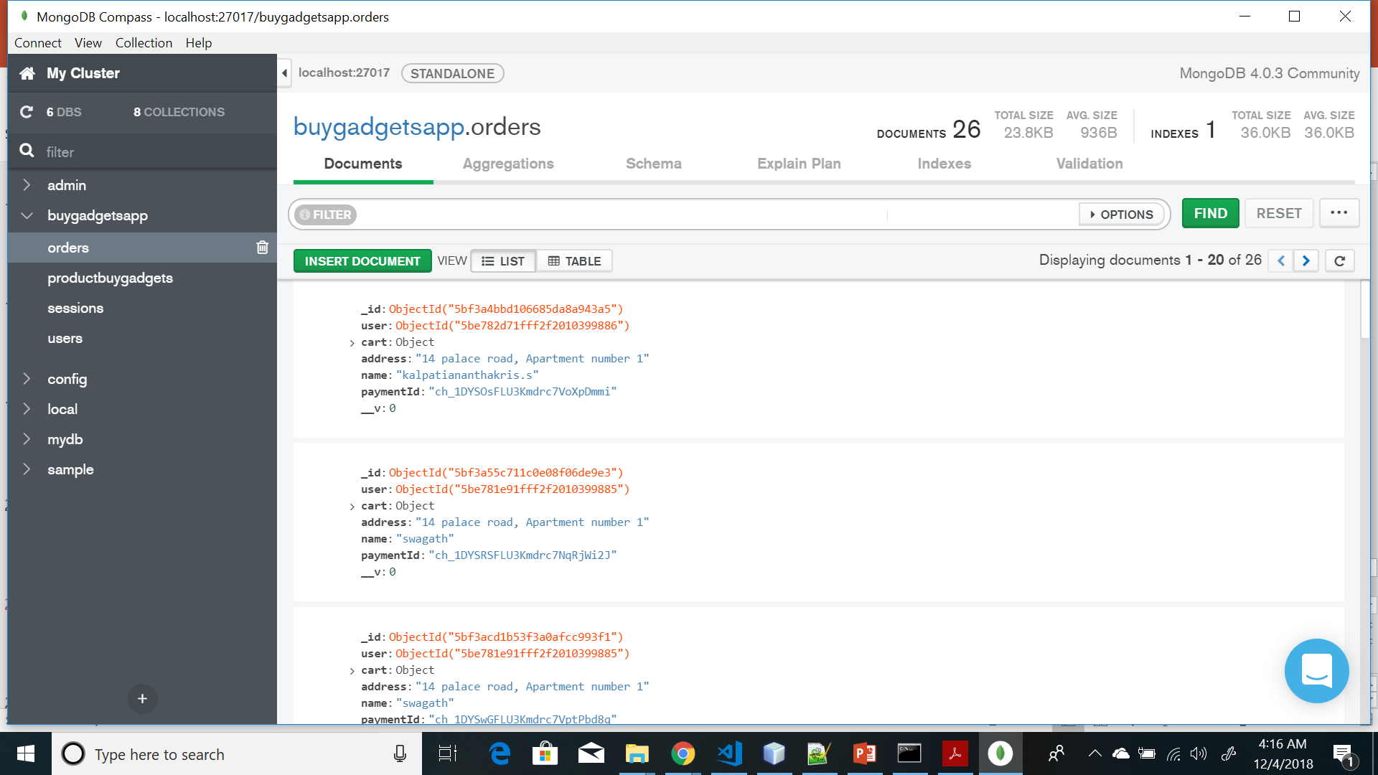
Orders Collection

Slide 32
Deployment
Steps:
Created Mlab account for hosting MongoDB database
Heroku account for deploying application
Application can be accessed using URL:https://sheltered-castle-69385.herokuapp.com/

Slide 33
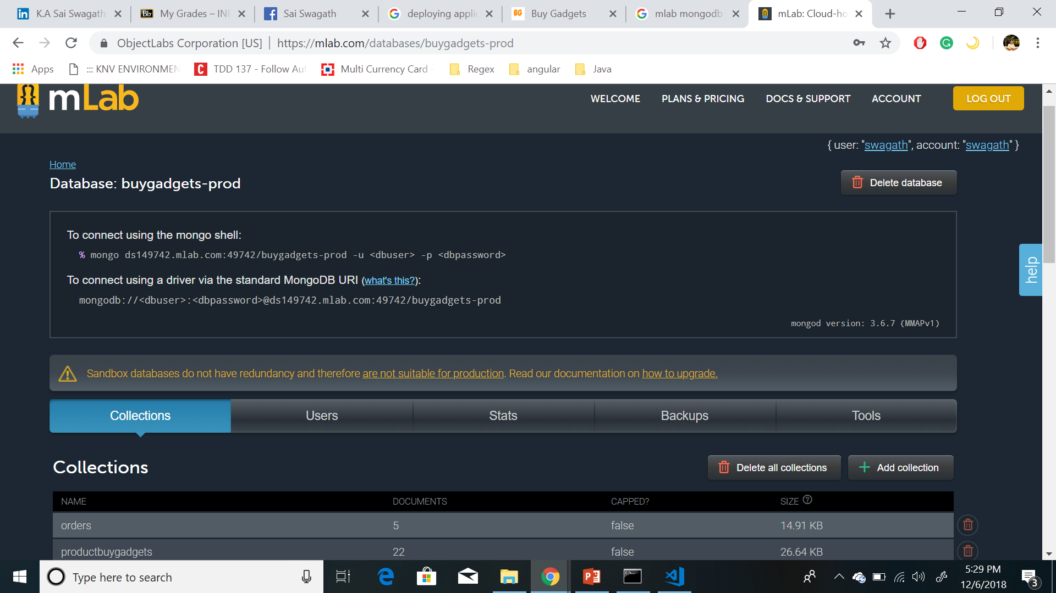
Mlab Account

Slide 34
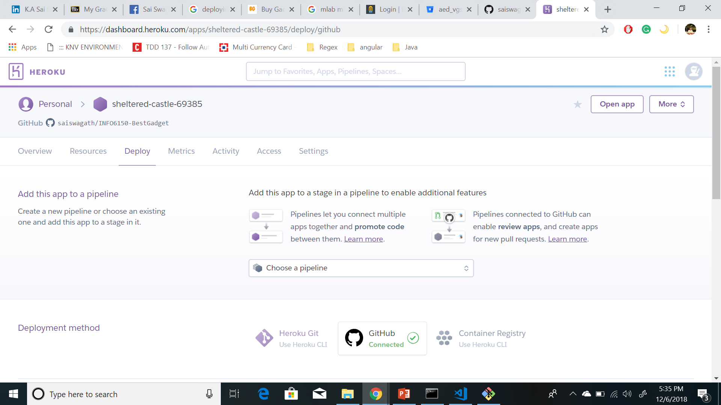
Heroku Account

Slide 35
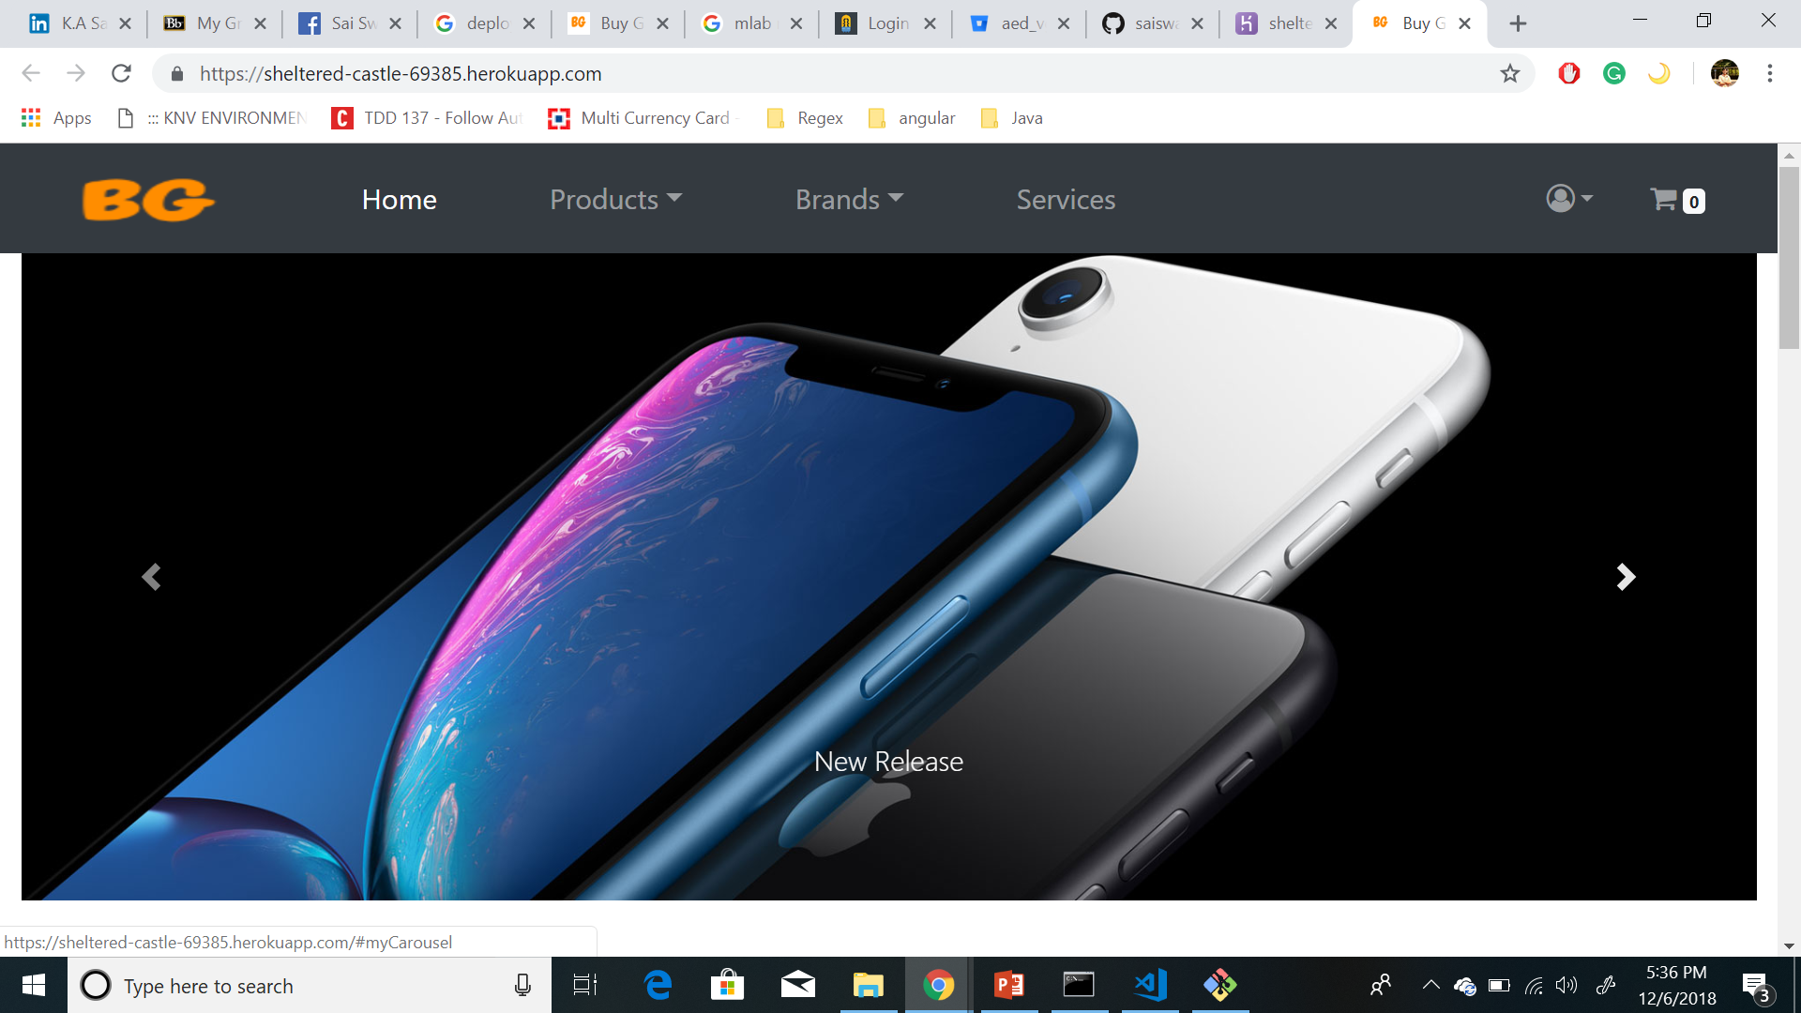
Post Deployment

Slide 36

Thank you
Professor: Vishal Chawla TA’s
Mihir Patil
Rishi Nandedkar

